Slide 1


Slide 2

The Concept
Premium Digital Storefront
Mi7fada is a conceptual e-commerce web application designed to sell premium leather bags.
Beyond just transactions, it serves as a soft-skills project demonstrating how modern web tools can create immersive brand experiences.

Slide 3
The Challenge
“Hon do ue bridge the gap between static product catalogs and the personalized assistance ofa physicalluxury boutique?“

Slide 4
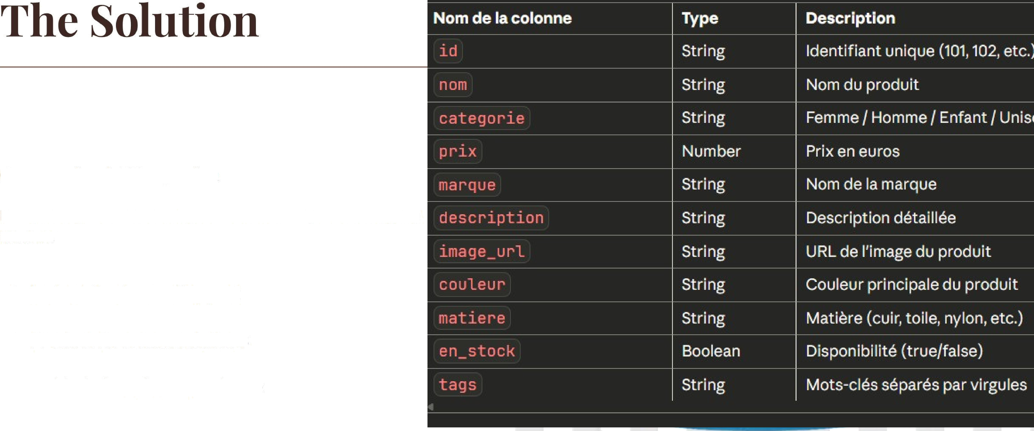
GonversationalAI Integration
Mi7fada integrates a 24/7 intelligent assistant directly into the shopping
inteJace.
1 Instant Customer Support
1 Product Recommendations
1 Guided Shopping Experience

Slide 5



Technical Architecture
Streamlit
Botpress API
The entire frontend is built with Streamlit, leveraging Python fora rapid, responsive, and data-friendly UI.
The conversational logic is handled by Botpress, connected seamlessly via API calls to the Streamlit application.

Slide 6


The AI is designed for reliability and consistency
using Botpress.
•*’ Knowledge Base: Pre-loaded with product details,
shipping policies, and store information.
+’ Hardcoded Logic: Ensures accurate, brand-safe responses without hallucinations.
+’ Efficiency: Handles FAQs instantly, reducing the need for human agents.

Slide 7
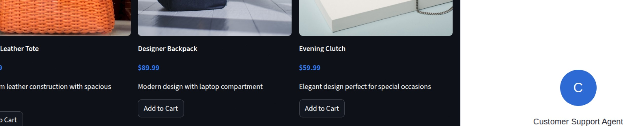
Sleek tâf Intuitive
The application demonstrates modern web development practices with a clean, minimalist aesthetic.
'
t•› •
“
Users can browse collections, filter items, and access the chatbot widget from any page, ensuring support is always one click away.
-
¥ . . _
.
- . - . -
“ 4 e . 8
6 “
" “ “
e
. d
“ “ 8 “ “ "
" e - 4 . “ . “ e ” . “ 8 e
“
a a o
* e e e
E

Slide 8
Project Goals: Sok Skills
M
Service Automation
Design Thinking
E-Commerce
Understanding how to automate customer interactions effectively.
Creating a user-centric interface that balances aesthetics and function.
Mastering the fundamentals of online business operations.

Slide 9
.
Instagram
Integration
' °
‹ - -
- - - .
Oninichamel Support
'*
° -
°
- “ - - °
The customer service isn t limited to the website. The Botpress agent is fully
integrated with the boutique's Instagram Business account.
' ' “
_ . › ‹ › -
,° |  | °, | ° | , | °) | ° |  |  | •x’ | Auto-Reply: Instantly responds to DMs regarding products and hours.
 |  |  |  |  |  |  |  |  | •*’ | Consistency: Uses the exact same knowledge base as the web chatbot.
 |  |  |  |  |  |  |  |  | •z’ | Engagement: Captures customers where they are
 | ° |  |  |  |  |  | ° | ° |  | most active.
O

Slide 10
Key Takeaways
Integration: Successfully bridging Python apps with external AI APIs.
Availability: Providing 24/7 support through automated knowledge bases.
Modern Stack: Utilizing Streamlit for rapid prototyping and deployment of business apps.

Slide 11
Questions?
Mi7fada Bags & Style

